Slide 2
AIR-HACK : THE AIR QUALITY CONTROL SYSTEM
Presenter name : Team CodeCatalyst
Title: Air-Hack- Air Quality Control System
Date: 31-09-2019

Slide 3
Agenda
Problem Statement
Solving the Problem-Our Product
Why Our Product????- features
Business Implications
Product Architecture
Technical Stack

Slide 4
PROBLEM STATEMENT

Slide 5
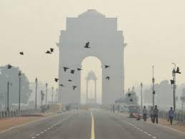
Air pollution has become a national emergency as it is killing one lakh children under the age of five in India every year.

Slide 6
Air pollution has become a national emergency as it is killing one lakh children under the age of five in India every year.
It is responsible for 12.5 percent of all deaths in the country, according to the fourth edition of State of India's Environment (SoE) Report, 2019.

Slide 7
Air pollution has become a national emergency as it is killing one lakh children under the age of five in India every year.
It is responsible for 12.5 percent of all deaths in the country, according to the fourth edition of State of India's Environment (SoE) Report, 2019.
Global reports on air pollution revealed that over 1.2 million people died in India due to air pollution in 2017.

Slide 8
Air pollution has become a national emergency as it is killing one lakh children under the age of five in India every year.
It is responsible for 12.5 percent of all deaths in the country, according to the fourth edition of State of India's Environment (SoE) Report, 2019.
Global reports on air pollution revealed that over 1.2 million people died in India due to air pollution in 2017.
Over 90 percent of people in the world live in areas with unhealthy levels of air pollutants as per guidelines set by the World Health Organization.

Slide 9
Air pollution has become a national emergency as it is killing one lakh children under the age of five in India every year.
It is responsible for 12.5 percent of all deaths in the country, according to the fourth edition of State of India's Environment (SoE) Report, 2019.
Global reports on air pollution revealed that over 1.2 million people died in India due to air pollution in 2017.
Over 90 percent of people in the world live in areas with unhealthy levels of air pollutants as per guidelines set by the World Health Organization.
Worldwide, air pollution reduced life expectancy by an average 20 months in 2017,

Slide 10
SOLVING THE PROBLEM-OUR PRODUCT

Slide 11
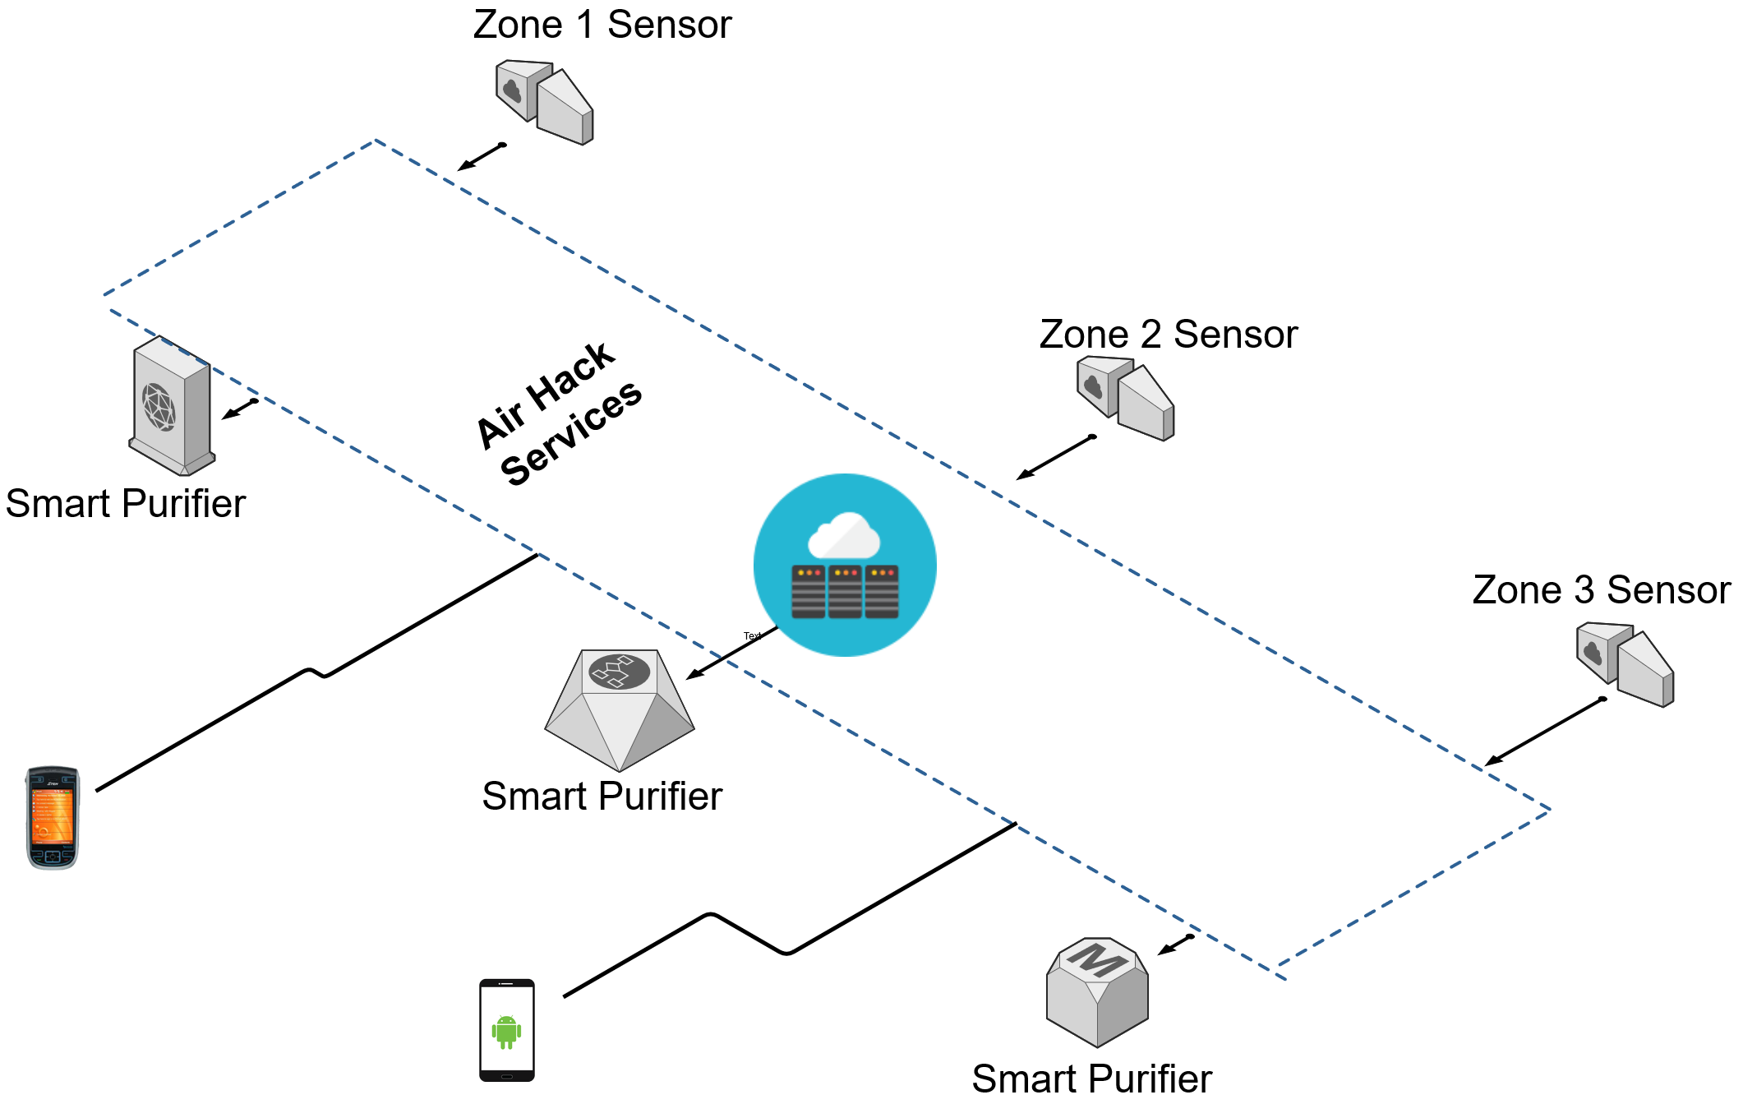
An IOT based Air Pollution Monitoring System is developed which will monitor the level of pollution and Air Quality .

Slide 12
An IOT based Air Pollution Monitoring System is developed which will monitor the level of pollution and Air Quality over a webserver using internet.
Sensors are deployed at various locations which can sense and collect the data.

Slide 13
An IOT based Air Pollution Monitoring System is developed which will monitor the level of pollution and Air Quality over a webserver using internet.
Sensors are deployed at various locations which can sense and collect the data.
The data can be uploaded on the Server which facilitates monitoring from any part.

Slide 14
An IOT based Air Pollution Monitoring System is developed which will monitor the level of pollution and Air Quality over a webserver using internet.
Sensors are deployed at various locations which can sense and collect the data.
The data can be uploaded on the Server which facilitates monitoring from any part.
Air quality can be displayed on the Android application(App) which makes Air Quality monitoring easy.

Slide 15
An IOT based Air Pollution Monitoring System is developed which will monitor the level of pollution and Air Quality over a webserver using internet.
Sensors are deployed at various locations which can sense and collect the data.
The data can be uploaded on the Server which facilitates monitoring from any part.
Air quality can be displayed on the Android application(App) which makes Air Quality monitoring easy.
An alarm can also be triggered when the air quality goes down beyond a certain level.

Slide 16
WHY OUR PRODUCT-FEATURES

Slide 17
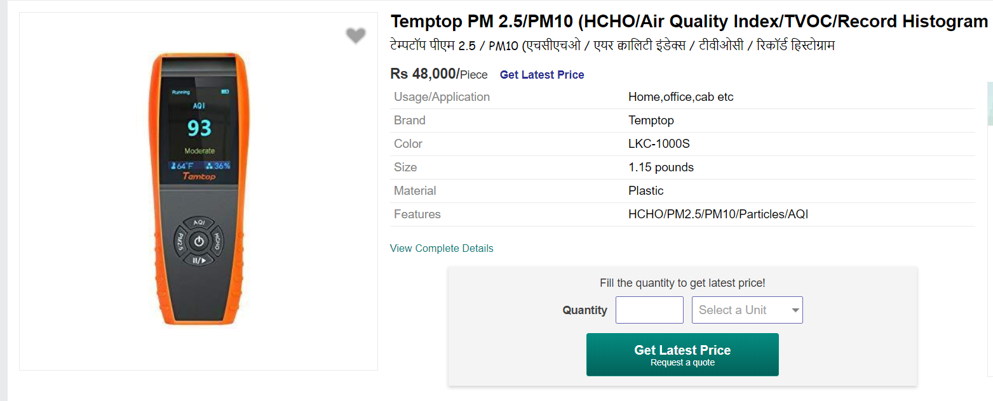
FEATURES OF OUR PRODUCT
Existing Products
Our Product
The existing products are costly, high power consuming and inaccurate.
The proposed system provides low cost, low power, compact and highly accurate system.

Slide 18
FEATURES OF OUR PRODUCT
Existing Products
Our Product
The existing products are stand-alone and requires manual controls and maintenance
This monitoring system is completely automated and requires very less human intervention and maintenance.

Slide 19
FEATURES OF OUR PRODUCT
Existing Products
Our Product
The sensors are based on electronic devices hence made system slow.
The flexible, light weight sensors make system efficient and fast.

Slide 20
FEATURES OF OUR PRODUCT
Existing Products
Our Product
The monitoring of existing stand-alone devices is constraint.
The dedicated sensors facilitates monitoring remotely from any place through Internet .

Slide 21
FEATURES OF OUR PRODUCT
Existing Products
Our Product
There is no concept of mobility in the existing systems up to date.
The APP(Android Application) provides the permission to the user to read the data provided by the server and accordingly switch on the purifier by authentication through user id and password.

Slide 22
BUSINESS IMPLICATIONS

Slide 23
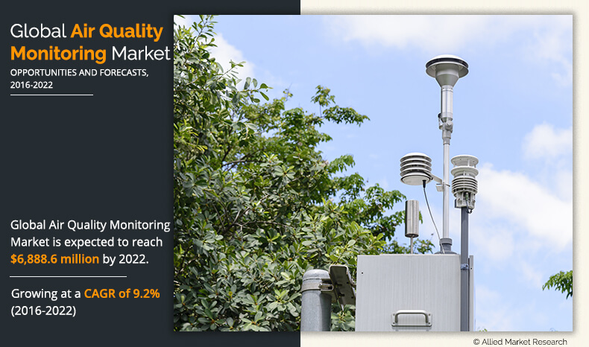

Slide 24
The report "Air Quality Monitoring System Market by Product (Indoor, Fixed, Outdoor, Wearable), Sampling (Continuous, Passive, Stack), Pollutant (Gas, VOC, Particulate Matter, Biological), End user (Government, Petrochemical, Commercial,) - Global Forecast to 2027", is expected to reach 6.69 billion by 2027 from USD 3.92 billion in 2017, at a CAGR of 4.6%.

Slide 25
SECTORS EMPLOYING AIR QUALITY CONTROL SYSTEMS
Government agencies
Academic institutes
Commercial users
Residential users
Petrochemical industry
Power generation plants
Pharmaceutical industry
Smart city authority

Slide 26
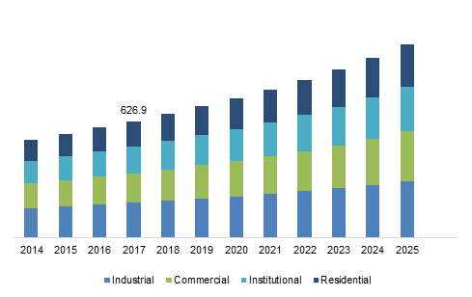
MARKET TRENDS

Slide 27
PROJECT ARCHITECTURE

Slide 28
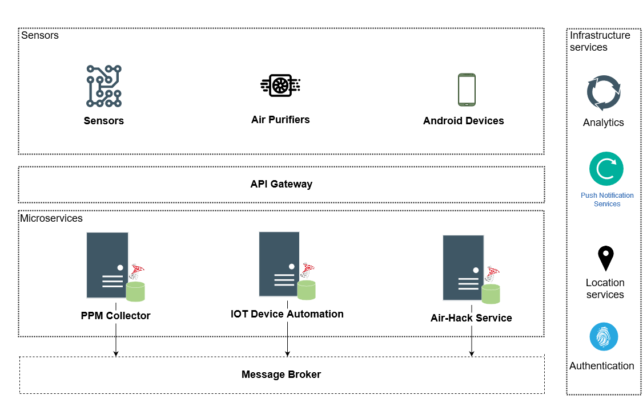
Architecture of Air-Hack Solution

Slide 29
TECHNICAL STACK

Slide 30
HARDWARE EQUIPMENTS
SOFTWARE REQUIREMENTS
Raspberry Pi 3
NodeMCU ESP8266
Motor
Fan Rotor
Led Light
Memory Card(16 GB)
Raspberry Pi Case
GP2Y1010AU0F Sensor
Android Studio 10
MySQL Workbench
Java Development Kit(JDK)
Retrofit
Mobaxtern
Arduino IDE
SQLite

